Slide 1
📍 Exploring NYC Airbnb Listings: Pricing & Popularity
By: Jennifer Szydlowski Course: Python for Data Analytics | CUNY Date: 04/10/2025

Slide 2

Goals: The primary goal of this project is to analyze the Airbnb rental market in New York City using data from 2014-2019. Aiming to understand the distribution of Airbnb listings across the city's neighborhoods and boroughs, price trends over time, and how these elements contribute to insights that can be valuable for both hosts and investors.
Key Objectives:
Understand the distribution across different neighborhoods and boroughs: This helps identify high-demand areas and understand market saturation. Insights gained could help hosts identify competitive neighborhoods and guide future investors about areas with the highest potential return on investment.
Analyze the pricing trends of Airbnb listings over time: This objective was designed to uncover possible trends in pricing across different years and months. Looking into price changes could also reveal insights related to economic shifts, tourist seasonality, and local events.
Examine the price distribution within the top neighborhoods: The focus here was on determining which neighborhoods are more premium and which provide more affordable options for guests. This could be useful for both travelers and hosts to better understand the pricing landscape in different neighborhoods.

Slide 3

Dataset Overview
Source: https://www.kaggle.com/datasets/dgomonov/new-york-cityairbnbopendata?resource=download&select=AB_NYC_2019.csv
Rows: 48,895
Columns: 16
Key columns used:
price
neighborhood_group (borough)
room_type
availability_365
reviews_per_month

Slide 4

Methodologies
Steps taken:
Cleaned missing values (last_review, reviews_per_month)
Converted dates
Filtered outliers (e.g., prices > $1000)
Created visualizations

Slide 5

Key Findings – Pricing & Location
Insights:
Manhattan has the most listings and highest prices
Room type affects price: Entire homes cost more than private/shared rooms
Visuals:
Top 10 NYC neighborhoods by listings
Number of listings by borough

Slide 6
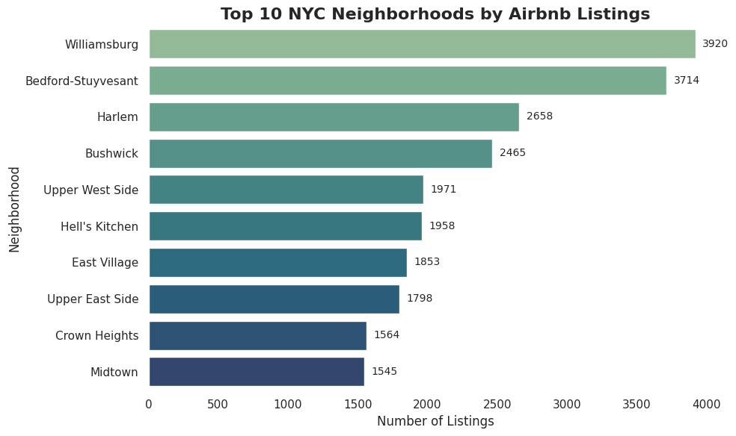
Brooklyn has the highest number of listings, especially in areas like Williamsburg and Bushwick, which reflects a high demand for short-term rentals. Manhattan also shows significant listings, especially in neighborhoods like SoHo and LES. This finding indicates which areas are most attractive to both hosts and guests.
By understanding the top neighborhoods, investors can identify lucrative areas for short-term rental investments.

Slide 7
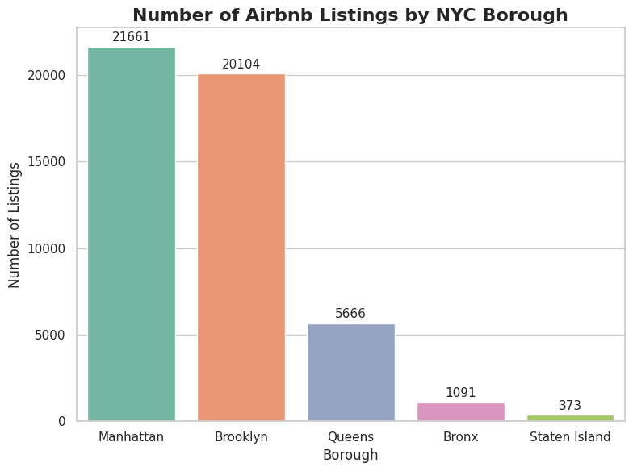
Manhattan remains the leader in terms of Airbnb listings, likely due to its dense concentration of tourists and attractions. Brooklyn follows closely. The relatively fewer listings in Queens and the Bronx indicate these boroughs might have lower demand for short-term rentals, but they could also present investment opportunities at lower price points.
This data helps investors decide where they may want to focus their efforts based on competition and demand, while hosts may choose boroughs based on the rental market’s saturation.

Slide 8
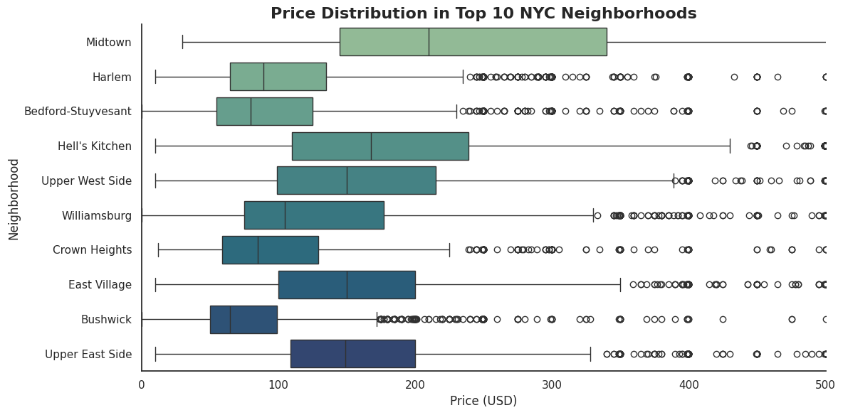
Higher-priced listings in neighborhoods like Manhattan and Brooklyn suggest premium pricing, while neighborhoods with a broader price range (e.g., Brooklyn) offer both budget and luxury options.
This visualization helps both hosts and guests assess whether they are pricing their properties too high or too low. Hosts can fine-tune their pricing strategy based on the price distribution in their neighborhood, while guests can make better-informed decisions on where to stay within their budget

Slide 9
Conclusion
Top Takeaways:
This project provides a detailed look into the Airbnb rental market in New York City by analyzing distribution, price trends, and demand. The insights gained can inform the strategies of Airbnb hosts aiming to optimize pricing, investors looking for high-potential areas, and tourists seeking to understand the price dynamics of short-term rentals in NYC. Additionally, this analysis contributes to understanding market growth, seasonality, and how neighborhood-specific trends can impact the success of Airbnb listings.
Next steps:
Explore changes in 2020–2023 to see COVID’s impact
Look into host-specific behaviors (e.g., superhosts)

Slide 10
GitHub & References
GitHub: https://github.com/Jennohh/python-class-201/blob/main/python_capstone.ipynb
Notebook: Python analysis in Google Colab
Data Source: https://www.kaggle.com/datasets/dgomonov/new-york-cityairbnbopendata?resource=download&select=AB_NYC_2019.csv
Libraries Used: Pandas, Seaborn, Matplotlib, NumPy

